Slide 1
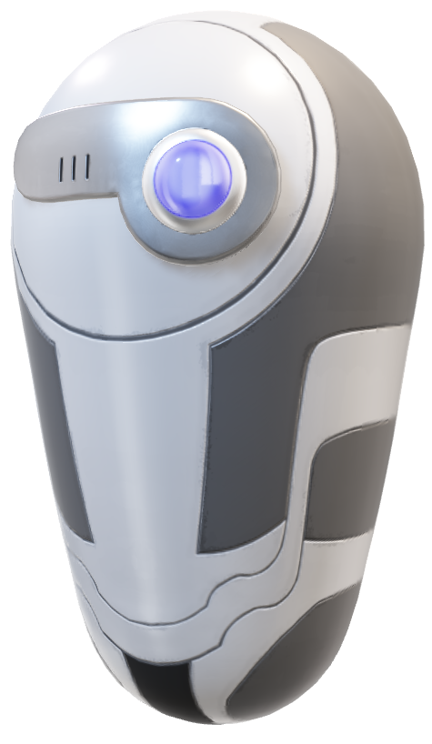
DROID
A company that creates all kinds of technology with the goal of helping people as quickly and efficiently as possible

Slide 2
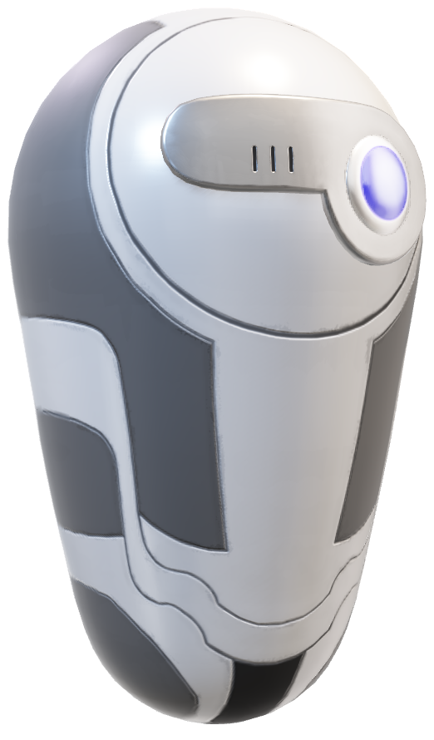
Table of contents
The team
The task
Technologies
Implement
Presentation

Slide 3
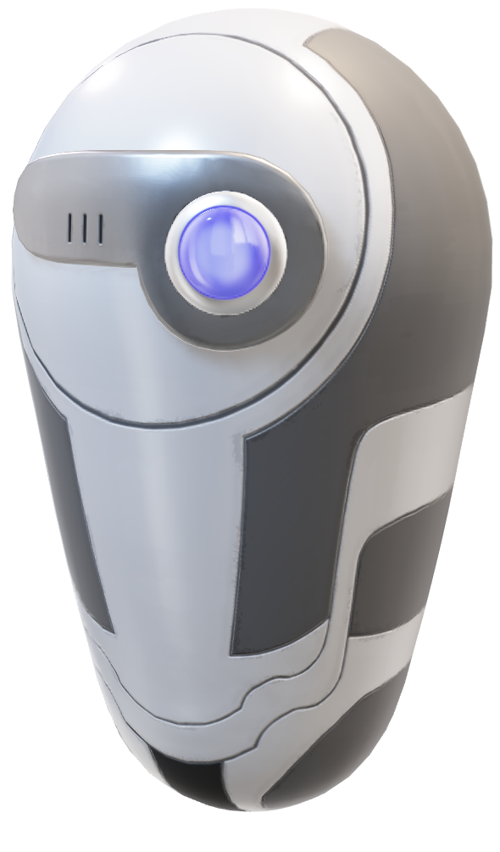
01
The Team
The people who created Droid

Slide 4
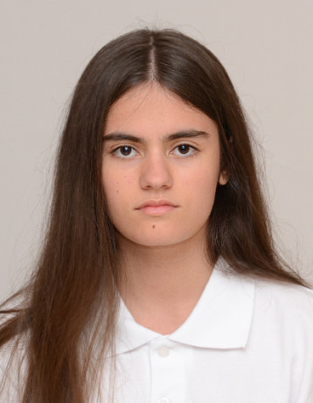
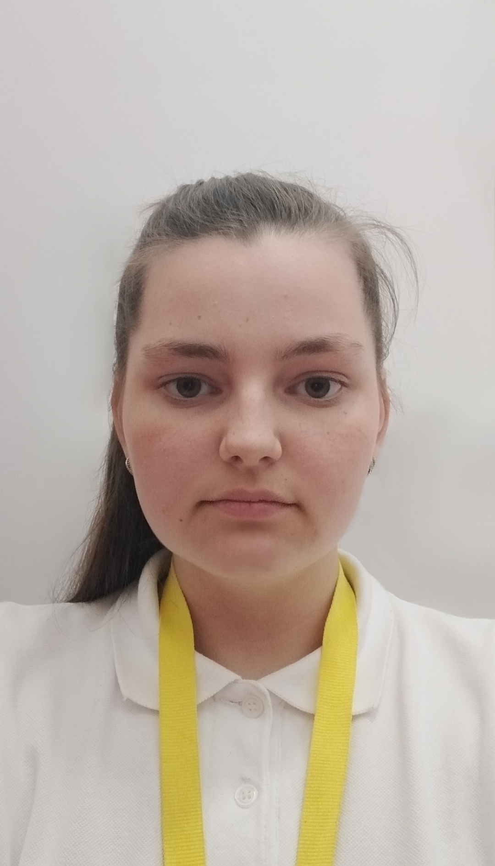
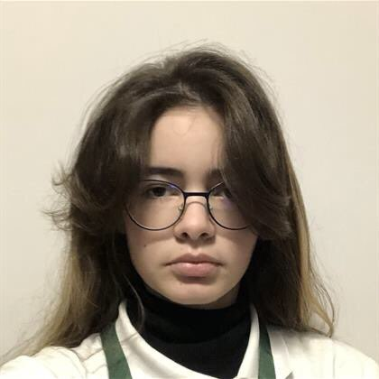
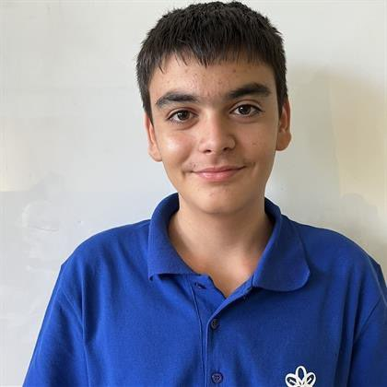



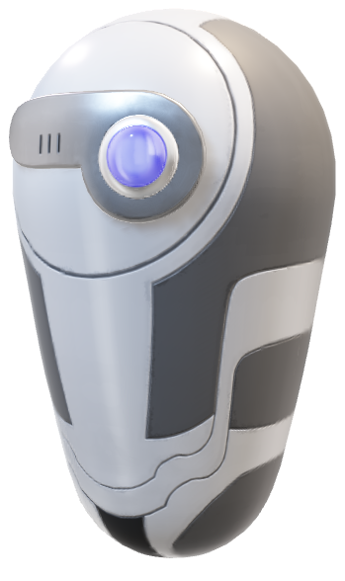
The Team
Iva Raikova
Natali Ribareva
Scrum Trainer
Rostislav Nikolov
Arina Popova
Designer
Front-end developer
Front-end developer
Maria Koleva
Mentor

Slide 5
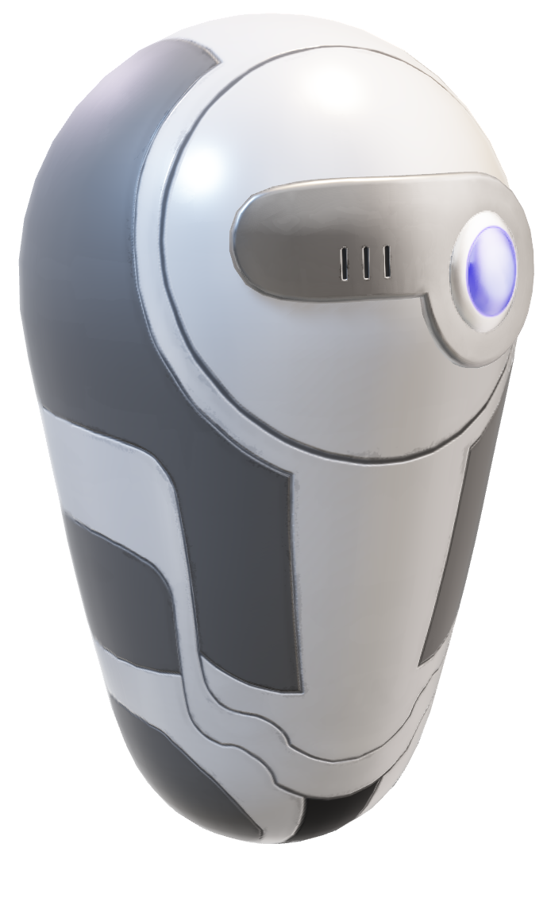
02
The Task

Slide 6
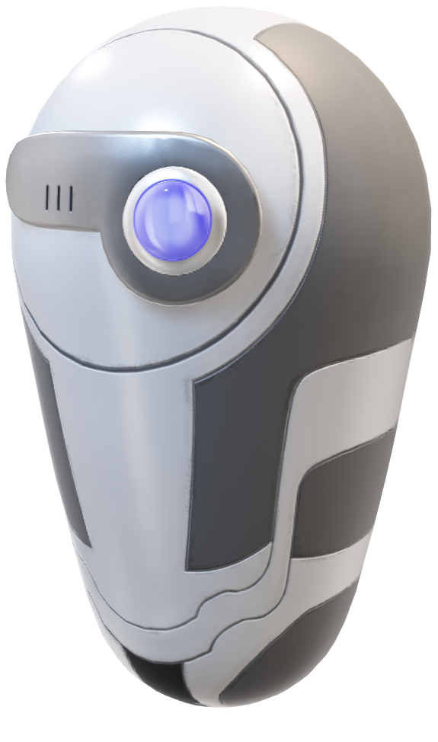
The Task
The idea behind Droid is to create innovative robotic machines that can assist in various spheres. We focus on employing effective working methods and maintaining a strong team that is always ready to help clients. Our equipment allows us to push the boundaries and expand our professional capabilities more and more.

Slide 7

03
Technologies
What does Droid use

Slide 8






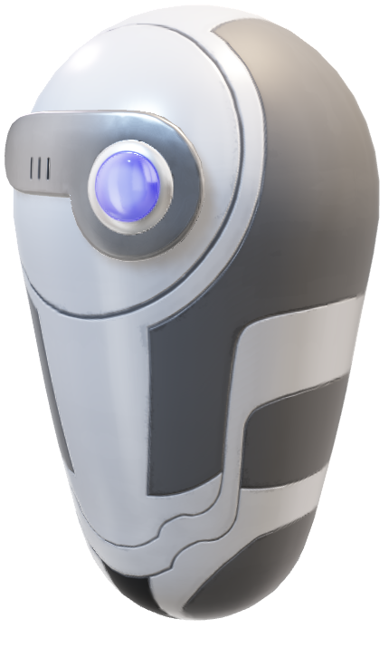
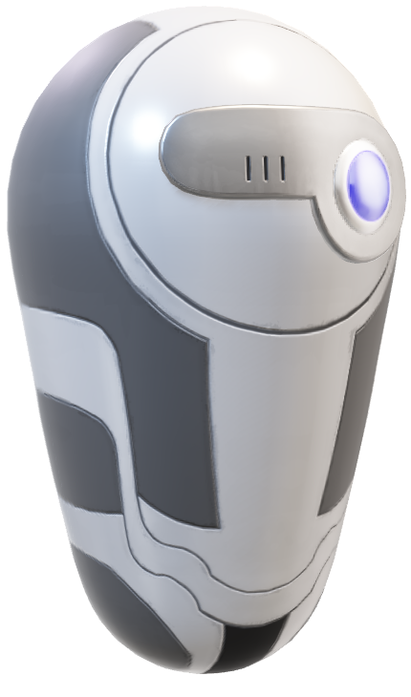
Technologies

Slide 9
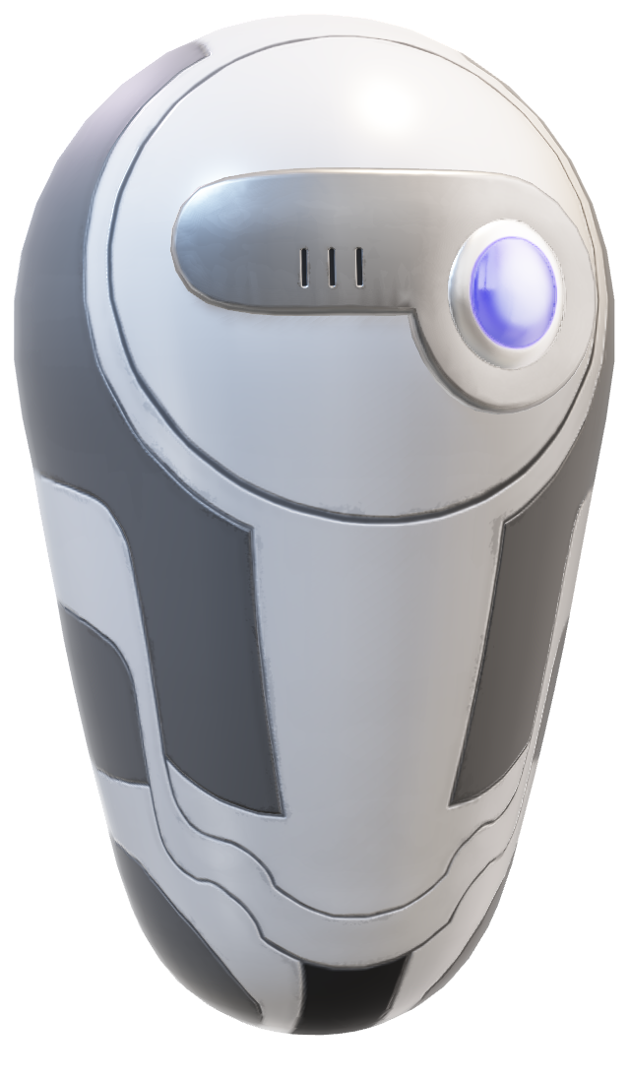
04
Implement

Slide 10
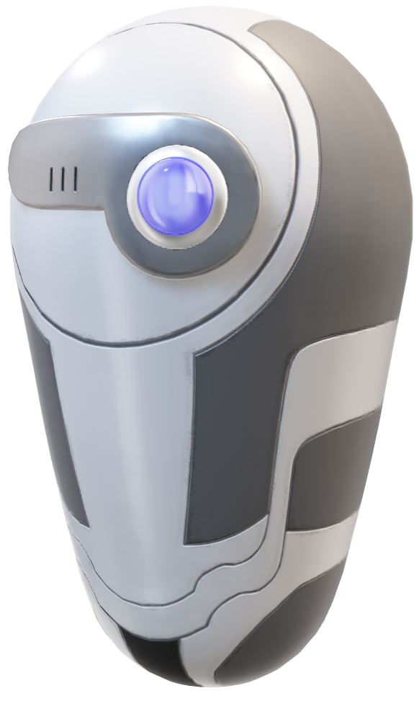
Implement
Droid tackled a challenging project, building our site from scratch in just one month. Though setup and organization, we adapted and persevered. With unwavering commitment, our team delivered exceptional results, demonstrating our ability to thrive under pressure.

Slide 11
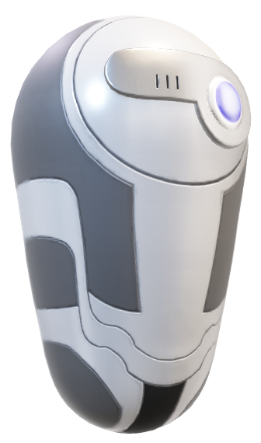
Let’s take a look at our site

